Slide 1


eduke
EDUKE
Academic Performance Prediction System with AI
A web-based AI-powered platform designed to track student performance, enhance communication, and provide predictive insights. By analyzing academic data, Eduke helps teachers and parents support students effectively, ensuring better learning outcomes.
SAIN SABURAJ
MCA 23
Notes:
Good morning everyone. Today, I am excited to present EDUKE – An Academic Performance Prediction and Management System. This AI-powered platform is designed to track student performance, enhance communication, and provide predictive insights to improve learning outcomes. My name is Sain Saburaj, and let's explore how Eduke is transforming education!"

Slide 2


eduke
Introduction to
EDUKE
Eduke is an AI-powered academic performance prediction and management system designed to enhance the learning experience for students, teachers, and parents. By analyzing key academic metrics such as attendance, marks, and student behavior, Eduke provides data-driven insights to predict performance trends.
The platform incorporates AI-Based Performance Prediction to assess student progress, an Automated Grading System to streamline quiz and assessment evaluations, and an Advanced AI Chatbot for academic guidance and query resolution. Additionally, Eduke features Auto-Generated Reports for attendance and performance tracking and an Adaptive Learning System that offers personalized study recommendations.
With seamless communication between students, teachers, and parents, Eduke aims to revolutionize how educational institutions monitor and improve student success.
Notes:
Eduke is a web-based AI-powered system designed to enhance the learning experience for students, teachers, and parents. It analyzes academic data, such as attendance, marks, and student behavior, to provide predictive insights. Key features include AI-based performance prediction, an automated grading system for quizzes, an advanced chatbot for academic guidance, auto-generated reports, and an adaptive learning system that personalizes study recommendations. By enabling seamless communication, Eduke aims to revolutionize student success monitoring.

Slide 3





eduke
Users of EDUKE
ADMIN
CLASS HEAD
SUBJECT HEAD
STUDENT
PARENT
Manages the system, adds and oversees classes and teachers, and ensures smooth operation of the platform.
Acts as the primary teacher for a class, manages student records, assigns subjects, and communicates with students and parents.
Handles subject-specific activities, including assessments, study materials, and direct communication with students.
Accesses study materials, submits assignments, participates in quizzes, and communicates with teachers for academic guidance.
Monitors the student’s academic progress, attendance, and performance while staying connected with teachers for updates.
Notes:
Eduke is designed to serve multiple users:
Admin manages the system, adding and overseeing classes and teachers.
Class Head (Teacher) is responsible for managing students and subjects in a class.
Subject Head handles subject-specific activities like assessments and study materials.
Students access study materials, submit assignments, and participate in quizzes.
Parents monitor their child's academic progress and communicate with teachers.
Each user has a distinct role in making Eduke an effective academic management system.

Slide 4
eduke
Users of EDUKE
Admin
The Admin is the highest authority in the Eduke system, responsible for managing the platform, ensuring smooth operations, and overseeing all user roles. This role is typically held by the head of an institution, which maintains control over the academic structure.
User Management: Adds, updates, and removes class heads (teachers) to ensure proper faculty distribution.
Class Management: Creates and manages class structures, and maintains an organized curriculum.
System Monitoring: Ensures the platform runs smoothly, resolving technical issues and maintaining security.
Data Oversight: Keeps track of academic records, teacher assignments, and institutional-level analytics.
Notes:
The Admin plays the central role in managing Eduke. This role is typically held by the institution's management.
User Management – Admins add, update, and remove class heads.
Class Management – They create and manage class structures and curricula.
System Monitoring – Ensures smooth operation and security.
Data Oversight – Tracks academic records, teacher assignments, and analytics.
Admins maintain the overall structure and functionality of the platform.

Slide 5
eduke
Users of EDUKE
Class Head
The Class Head is responsible for managing a specific class, overseeing students, and ensuring a structured learning environment. They act as the bridge between students, parents, and subject heads.
Student Management: Adds, updates, and removes student records, ensuring accurate academic data.
Academic Oversight: Adds subjects and subject heads, monitors their progress, and ensures proper curriculum delivery.
Study Material Management: Updates the students with latest news and announcements
Communication: Maintains direct communication with students, parents and subject teachers of the class through Eduke Chat.
Notes:
The Class Head acts as the main teacher for a class and ensures smooth academic operations.
Student Management – Adds, updates, and removes student records.
Academic Oversight – Assigns subjects and subject heads, ensuring proper curriculum delivery.
Study Material Management – Uploads learning resources and announcements.
Communication – Uses Eduke Chat to interact with students, parents, and subject teachers.
Class heads play a vital role in bridging communication between students, parents, and the school.

Slide 6
eduke
Users of EDUKE
Subject Head
The Subject Head specializes in managing subject-related academic activities and ensuring that students receive quality education in their respective subjects.
Content Management: Uploads, study materials for students with important subject wise announcements.
Student Support & Communication: Addresses students, communicate with parents, class head and other subject heads of the class through Eduke Chat.
Assessments & Evaluations: Conducts quizzes, evaluates student performance, and takes attendance, uploads examination marks, etc.
Observation & Evaluation: Provides structured feedback on student performance in the subject, considering classroom participation, test scores, and comprehension levels.
Notes:
The Subject Head focuses on subject-specific activities.
Content Management – Uploads study materials and subject-related announcements.
Student Support & Communication – Assists students and collaborates with parents, class heads, and other subject teachers through Eduke Chat.
Assessments & Evaluations – Conducts quizzes, tracks attendance, and uploads exam marks.
Observation & Evaluation – Provides structured feedback on student performance.
This role ensures that subject knowledge is well managed and delivered effectively.

Slide 7
eduke
Users of EDUKE
Student
The Student is at the center of the Eduke system, using the platform for learning, performance tracking, and communication with teachers. Eduke helps students to improve their learning experience.
Study Resources: Accesses study materials, assignments, and quizzes to support learning.
Communication: Chats with the class head and subject heads to clarify doubts and receive academic guidance through Eduke Chat.
Performance Tracking: Views marks, attendance records, and progress reports to analyze their strengths and weaknesses.
Quizzes & Assignments: – Participates in assessments and submits assignments through the platform.
Notes:
Students are the primary users of Eduke, benefiting from its various features.
Study Resources – Access to study materials, quizzes, and assignments.
Communication – Uses Eduke Chat to interact with class heads and subject heads for academic support.
Performance Tracking – Views marks, attendance, and progress reports.
Quizzes & Assignments – Completes assessments and submits assignments digitally.
Eduke empowers students to take control of their learning journey with structured academic support.

Slide 8
eduke
Users of EDUKE
Parent
The Parent plays a vital role in monitoring and supporting the student's academic journey. With Eduke, parents can stay informed about their child’s progress and maintain communication with teachers.
Progress Monitoring: Regularly tracks student attendance, marks, and feedback to stay updated on their academic performance.
Communication with Teachers: Connects with the class head to discuss student progress and academic guidance through Eduke Chat.
Feedback & Support: Provides insights on the student’s learning behavior and collaborates with teachers to ensure better educational support.
Observation & Evaluation: Parents can submit evaluations on their child’s study habits, participation, etc. helping teachers understand the student’s learning environment at home.
Notes:
Parents play a crucial role in a student’s academic progress. Eduke provides them with tools to stay informed.
Progress Monitoring – Tracks attendance, marks, and feedback.
Communication with Teachers – Uses Eduke Chat to interact with the class head.
Feedback & Support – Shares insights on the student’s learning habits.
Observation & Evaluation – Submits evaluations about the student's study habits, participation, and challenges to help teachers provide better support.
With Eduke, parents are more involved in their child’s education.

Slide 9
eduke
Requirements of EDUKE
Software Requirements
Operating System: Windows 10/11, Linux, macOS
Browser: Google Chrome, Brave, Firefox, Edge
Backend: Python (Django)
Database: MySQL
Frontend: HTML, TailwindCSS, JavaScript
Tools Used: VS Code, Canva
Notes:
Eduke is a web-based system and requires the following software:
Operating System – Windows 10/11, Linux, macOS.
Browser – Google Chrome, Brave, Firefox, Edge.
Backend – Developed using Python (Django).
Database – MySQL.
Frontend – Built with HTML, TailwindCSS, and JavaScript.
Tools Used – VS Code for development and Canva for design.
These technologies ensure a smooth and scalable system.

Slide 10
eduke
Requirements of EDUKE
Hardware Requirements
Processor: Intel Core i3 or higher
RAM: 4GB (8GB for smooth performance)
Storage: Minimum 20GB free space
Internet: Stable connection
Notes:
For the best performance, Eduke requires:
Processor – Intel Core i3 or higher.
RAM – At least 4GB (8GB recommended for smooth performance).
Storage – Minimum 20GB of free space.
Internet – A stable connection for online access.
These hardware requirements ensure efficient functioning across different devices.

Slide 11
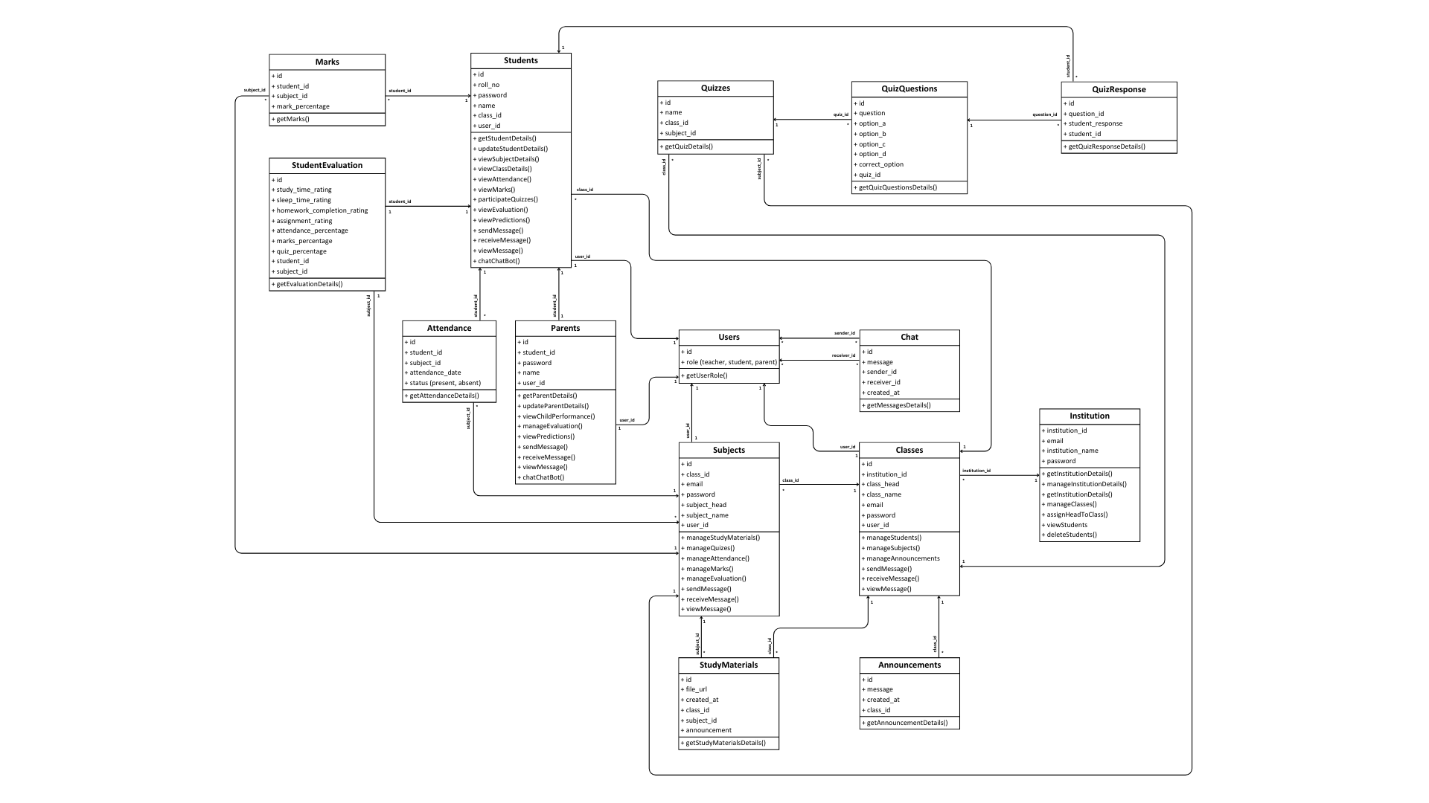
eduke
Class Diagram
Notes:
Class Diagram – Shows the relationships between different entities in the system.

Slide 12
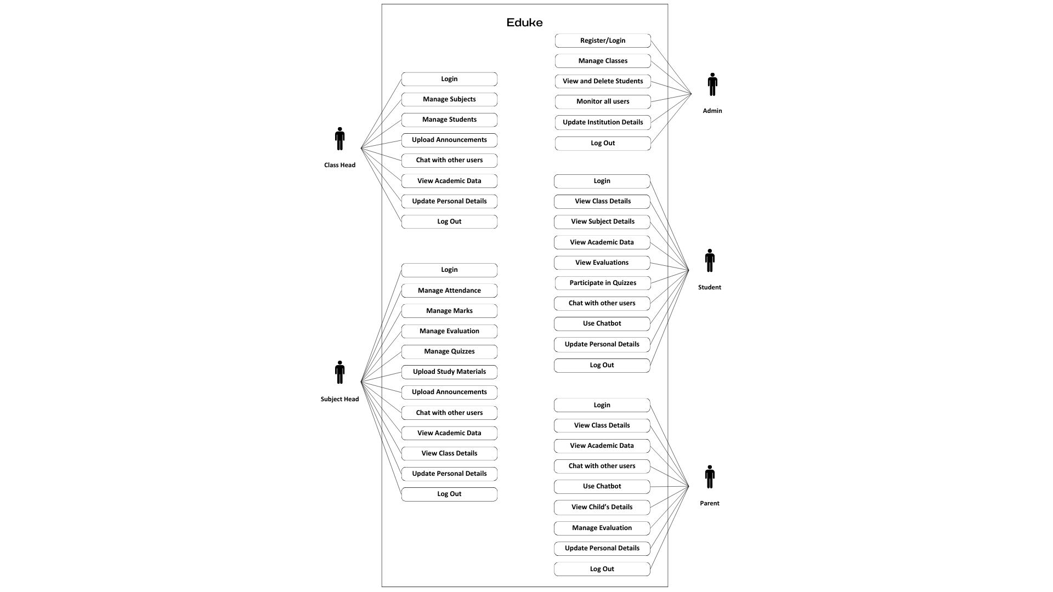
eduke
Use Case Diagram
Notes:
Use Case Diagram – Displays how different users interact with Eduke.

Slide 13
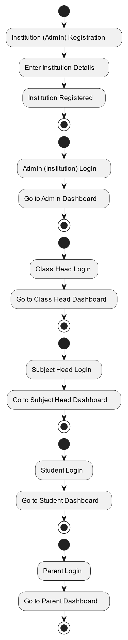
eduke
Activity Diagram - Authentication
Notes:
Activity & Sequence Diagrams – Illustrate various processes such as authentication, class management, and student activities.

Slide 14
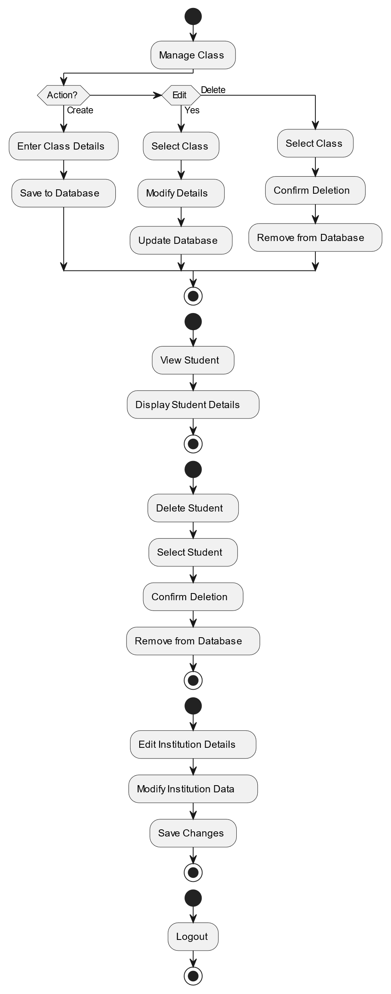
eduke
Activity Diagram - Admin

Slide 15
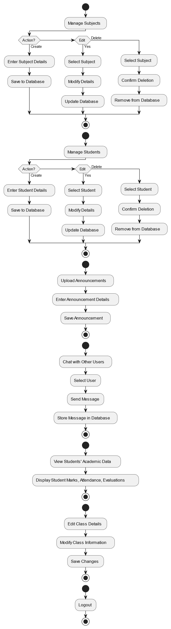
eduke
Activity Diagram - Class Head

Slide 16
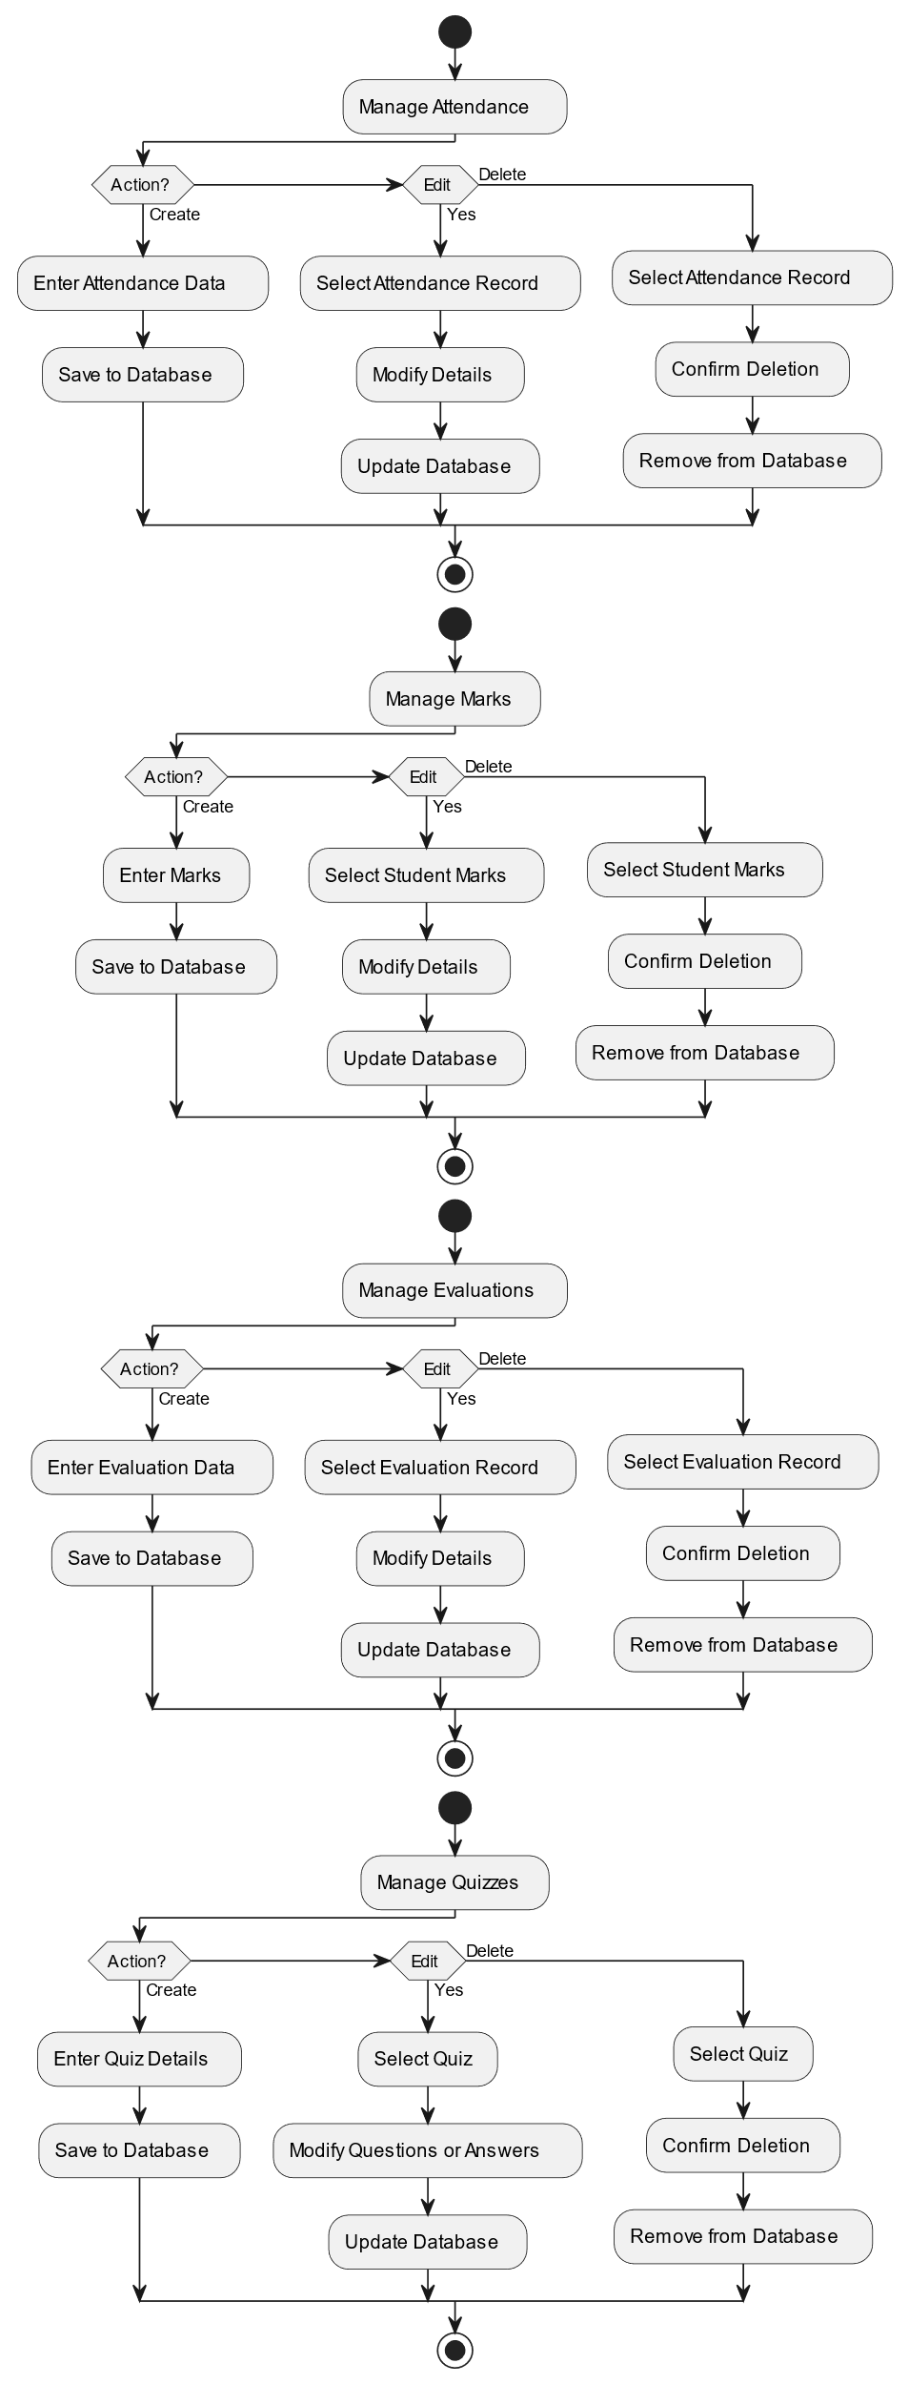
eduke
Activity Diagram - Subject Head

Slide 17
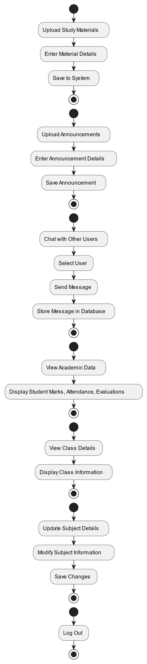
eduke
Activity Diagram - Subject Head

Slide 18
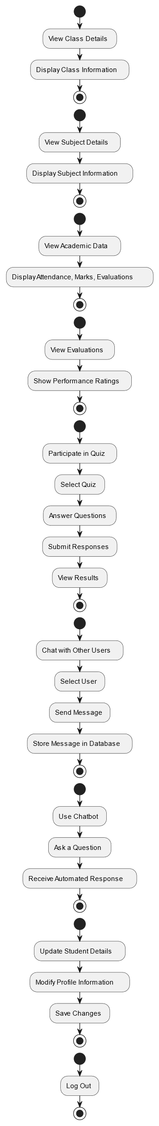
eduke
Activity Diagram - Student

Slide 19
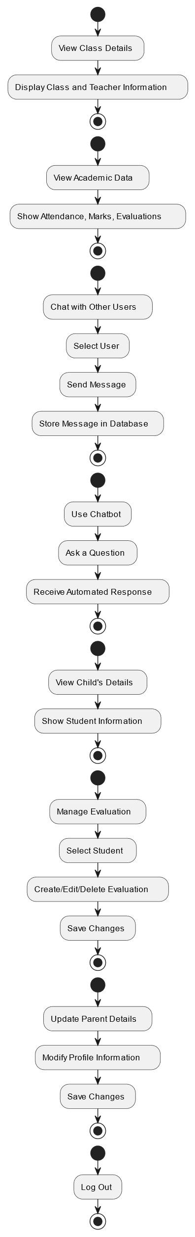
eduke
Activity Diagram - Parent

Slide 20
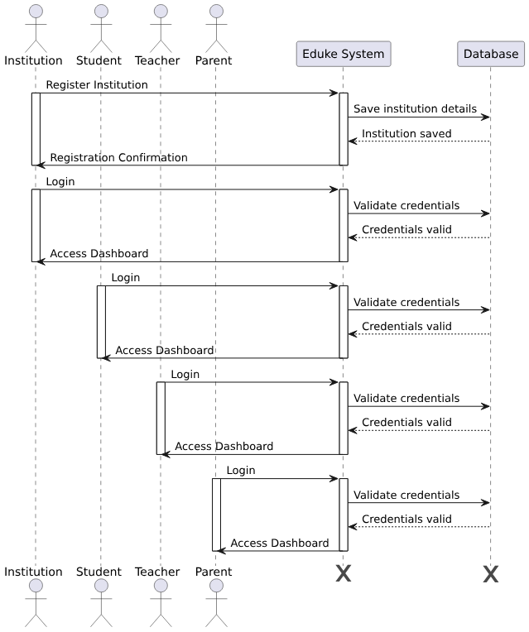
eduke
Sequence Diagram - Authentication

Slide 21
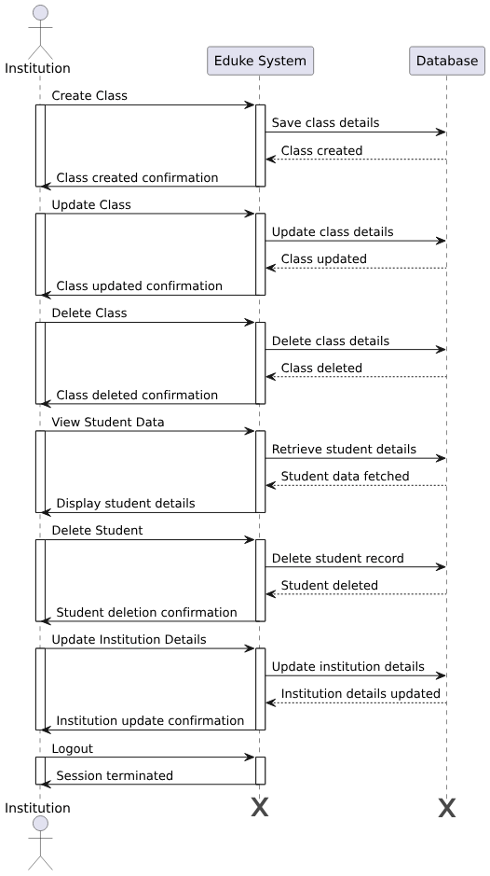
eduke
Sequence Diagram - Admin

Slide 22
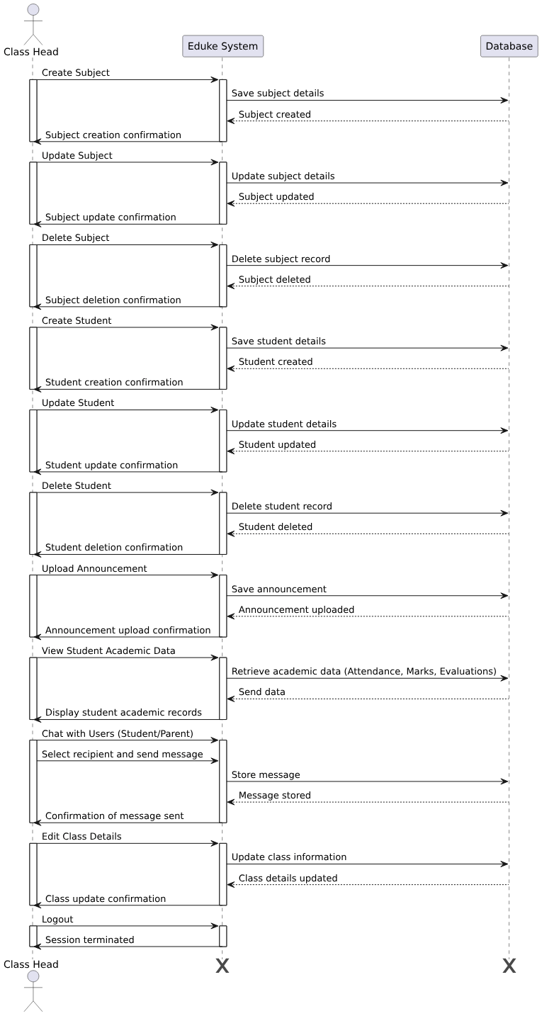
eduke
Sequence Diagram - Class Head

Slide 23
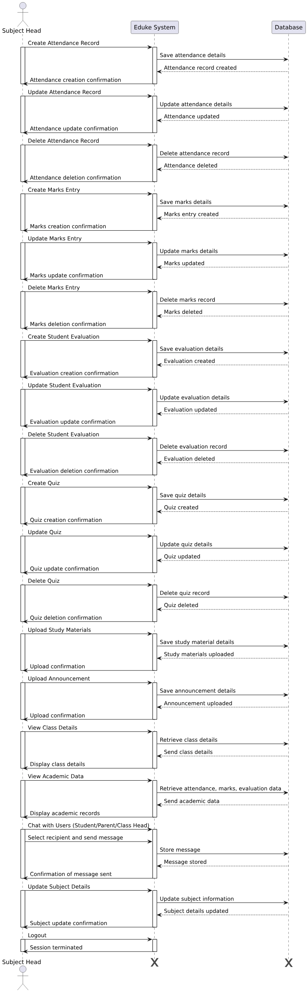
eduke
Sequence Diagram - Subject Head

Slide 24
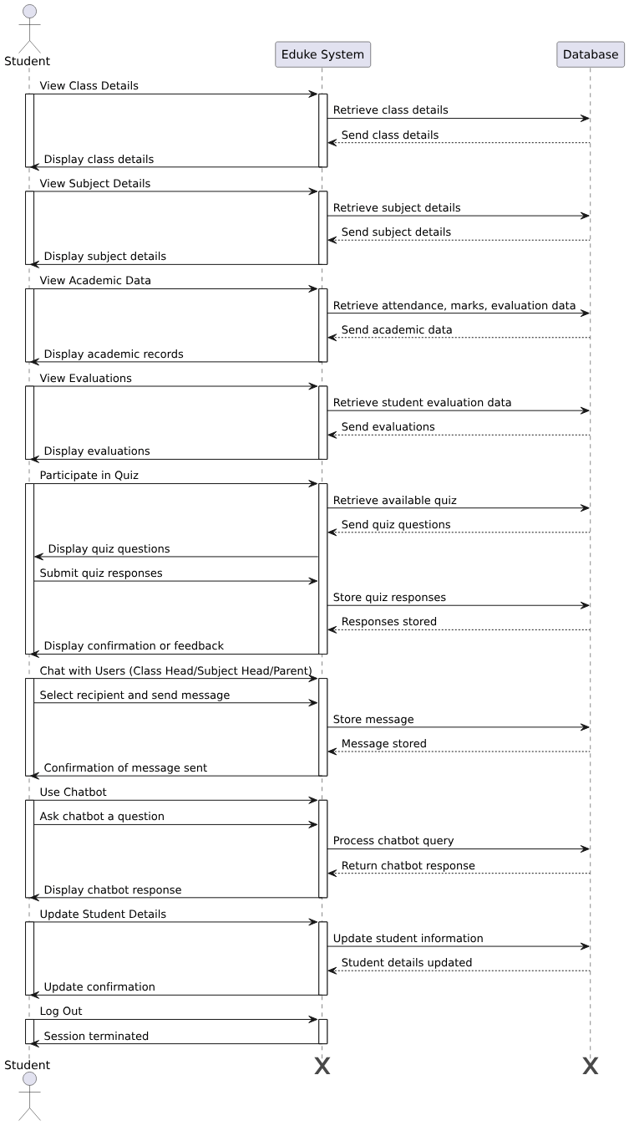
eduke
Sequence Diagram - Student

Slide 25
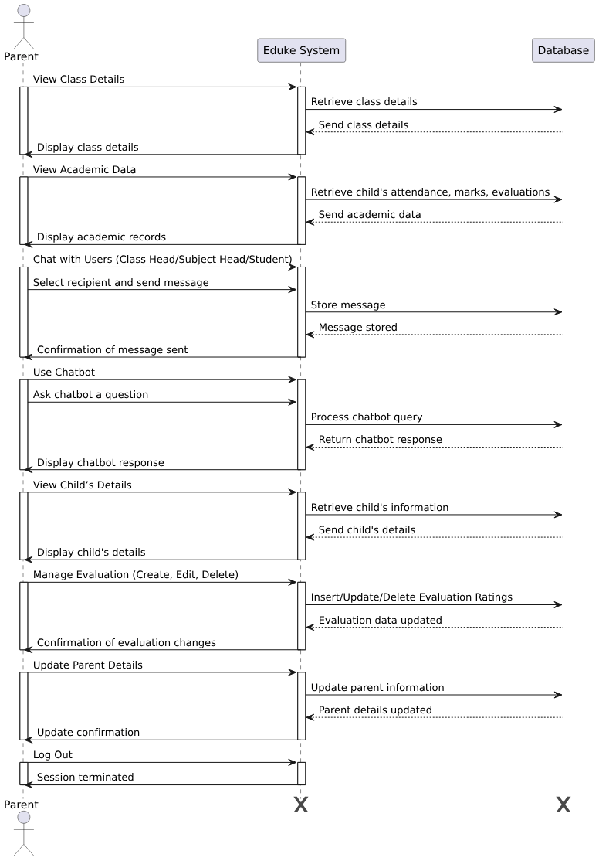
eduke
Sequence Diagram - Parent
Notes:
These diagrams help in understanding the system’s technical architecture and functionality.

Slide 26
eduke
EDUKE Future Enhancements
Enhanced Security: Strengthening security measures with two-factor authentication and better role-based access controls.
Parent-Teacher Meeting Scheduler: Allowing parents and teachers to schedule virtual or in-person meetings through the platform for better collaboration.
Mobile App Integration: Developing a mobile application to provide seamless access to Eduke’s features on smartphones and tablets.
Multi-Language Support: Expanding the platform to support multiple languages, making it accessible to a diverse range of users.
Handwritten Notes Recognition: Integrating AI-based recognition to convert handwritten notes into digital format for easy access and sharing.
AI-Powered Study Planner: Providing personalized study plans based on students’ performance, deadlines, and time availability.
Gamified Learning: Introducing interactive and gamified learning modules to keep students engaged while improving their academic performance.
Notes:
Eduke will continue to evolve with new features, including:
Enhanced Security & Role-Based Access – Strengthening authentication methods.
Parent-Teacher Meeting Scheduler – Facilitating better communication.
Mobile App Integration – Developing an app for better accessibility.
Multi-Language Support – Making the platform inclusive for diverse users.
Handwritten Notes Recognition – Converting notes into digital text.
AI-Powered Study Planner – Providing personalized study plans.
Gamified Learning – Adding interactive features to keep students engaged.
These enhancements will make Eduke even more effective.

Slide 27
eduke
Conclusion
Eduke is an innovative AI-powered platform designed to enhance academic performance tracking and management. By integrating predictive analytics, real-time communication, and structured data management, it bridges the gap between students, teachers, and parents. With its user-friendly interface and intelligent features, Eduke empowers educational institutions to make data-driven decisions, ensuring better learning outcomes and academic success.
Eduke transforms education through data-driven insights, fostering a smarter and more connected learning environment.
Notes:
Eduke is an innovative AI-powered academic platform that enhances learning by providing data-driven insights. By integrating predictive analytics, structured communication, and role-based management, it bridges the gap between students, teachers, and parents.
With features like automated evaluations, adaptive learning recommendations, and real-time progress tracking, Eduke transforms traditional education into a smarter, more connected experience.

Slide 28



eduke
THANK YOU
We appreciate your time and interest in
EDUKE
An Academic Performance Prediction and
Management System.
For GitHub Repository
www.github.com/theRealSain/eduke
Contact
sainsaburaj@depaul.edu.in
Notes:
Thank you all for your time and attention. Eduke is designed to revolutionize academic performance tracking, and I hope this presentation gave you valuable insights into its impact. I’d be happy to take any questions now.

